Slide 1
EIT x Soft Robots: project update
Week of Monday 10/05/2021

Slide 2
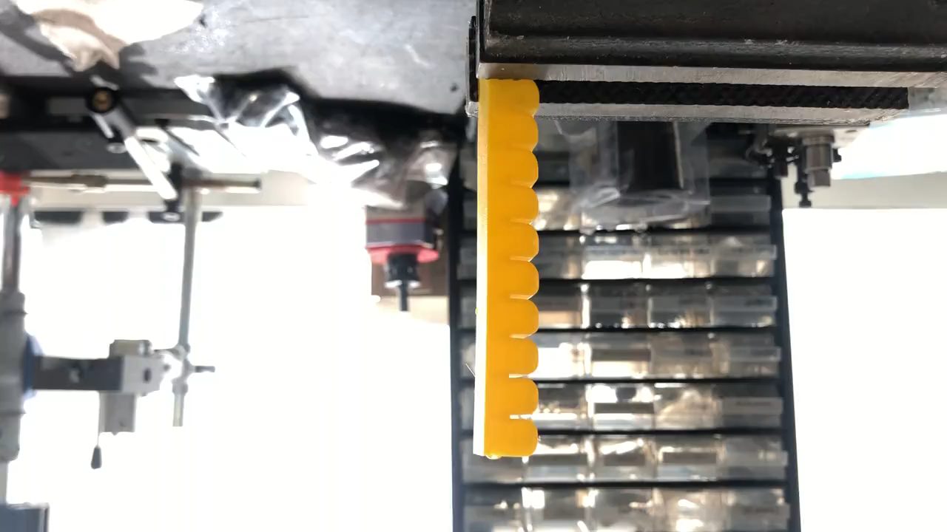
Not included last week: video of actuator moving with water
2 3 4

Slide 3
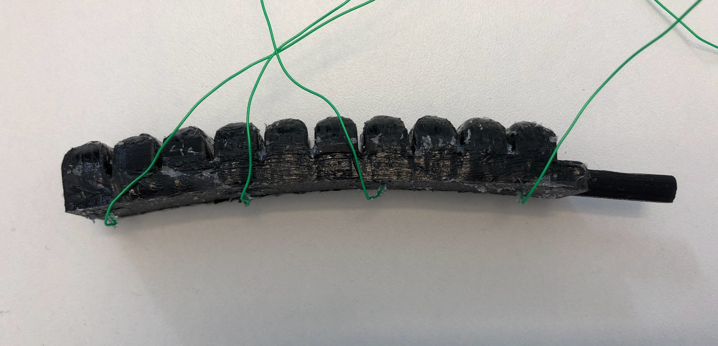
To do 1: reinforce electrode wire surface with silicone
Silicone layer to affix electrode
wires to actuator surface

Slide 4
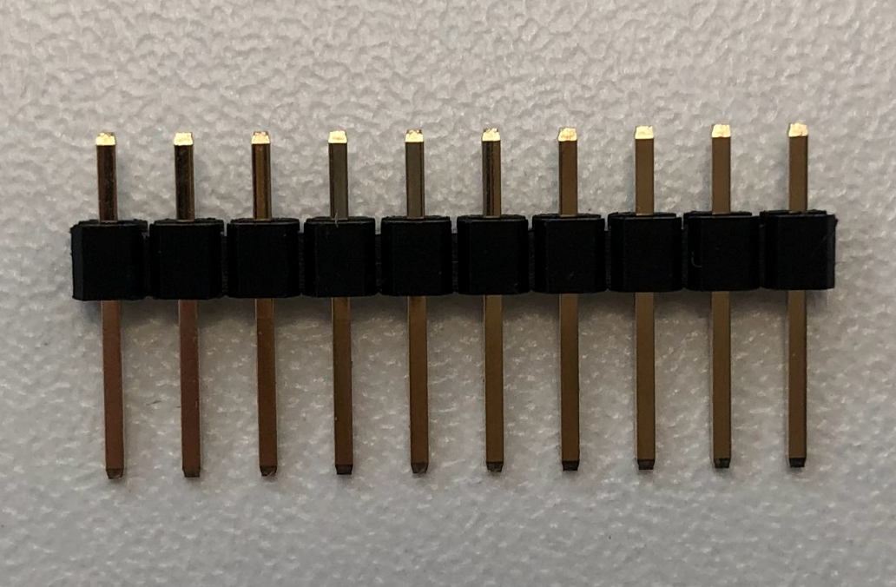
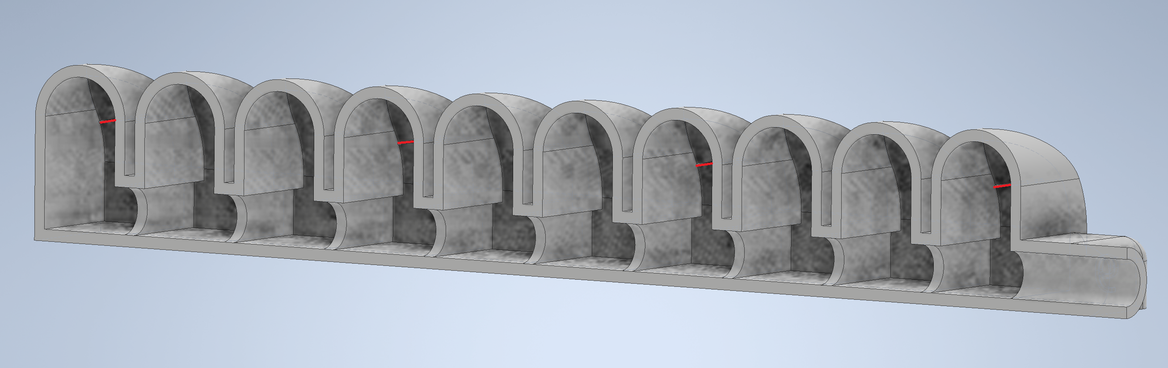
To do 2: thicker walls to hold electrode pins
Electrode pin
Electrode made from inserting header pin into actuator during printing

Slide 5
To do 3: make silicone actuator approximation to test EIT
Silicone rectangular prism, ~3mm thick
~100mm
~20mm
~20mm
Electrode
EIT system

Slide 6
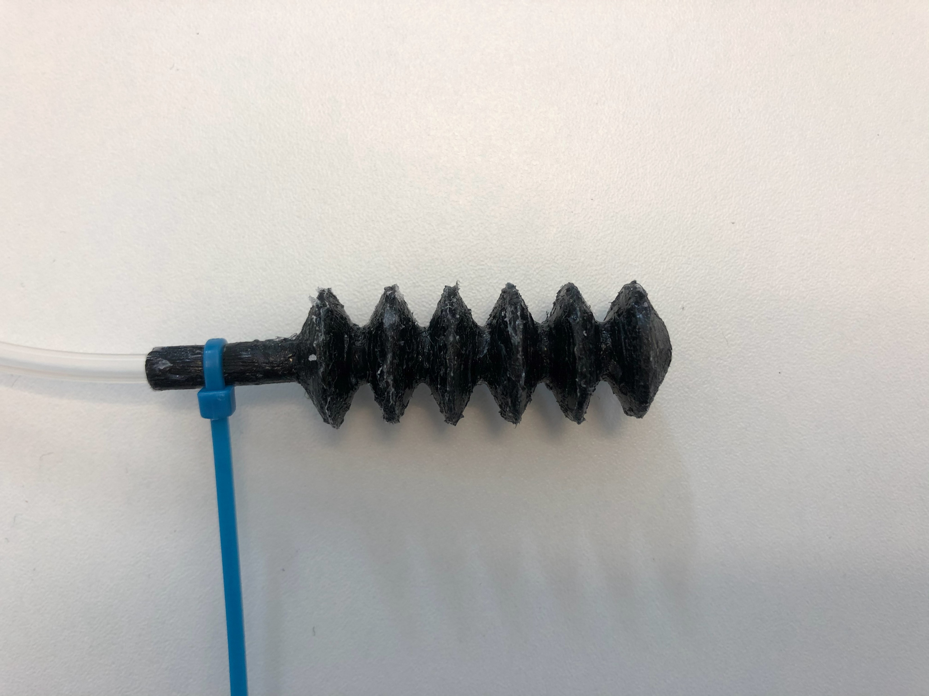
Something else I tried (to see how well it’d work)

